Slide 1
Management for Engineers Module-I By Neeti Saxena Assistant Professor

Slide 2
Questions for the Session
Who Are Managers?
Explain how manager differ from non-managerial employees.
Discuss how to classify managers in organizations.
What Is Management?
Define management.
Contrast efficiency and effectiveness.
Explain why efficiency and effectiveness are important to management.

Slide 3
Questions
What Do Managers Do?
Describe the four functions of management.
Explain Mintzberg’s managerial roles.
Describe Katz’s three essential managerial skills and how the importance of these skills changes depending on managerial level.
Discuss the changes that are impacting managers’ jobs.
Explain why customer service and innovation are important to the manager’s job.

Slide 4
Questions
What Is An Organization?
Describe the characteristics of an organization.
Explain how the concept of an organization is changing.
Why Study Management?
Explain the universality of management concept.
Discuss why an understanding of management is important even if you don’t plan to be a manager.
Describe the rewards and challenges of being a manager.

Slide 5
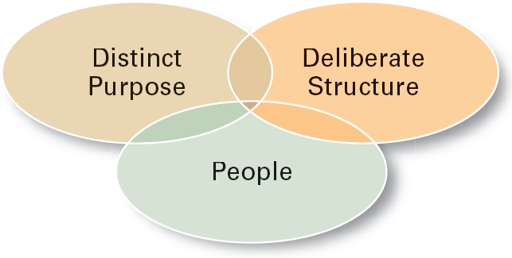
What Is An Organization?
An Organization Defined
A deliberate arrangement of people to accomplish some specific purpose
Common Characteristics of Organizations

Slide 6
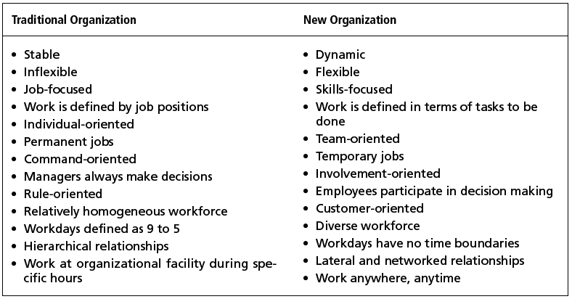
Traditional VS New

Slide 7
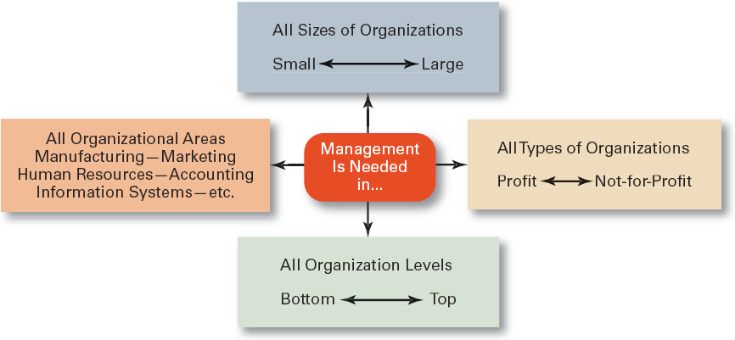
Why Study Management ?

Slide 8
Managerial Skills at different levels
Managerial Skills
Professor Robert L. Katz has popularized the concept of "Managerial Skills"
Technical skills: Lower Level
Human skills: Middle Level
Conceptual skills: Top Level
5 more skills can be stated : 1. Design skills 2. Administrative skills 3. Decision Making skills 4. Communication skills 5. Leadership skills
Notes:
Technical skills
Knowledge and proficiency in a specific field
Human skills
The ability to work well with other people
Conceptual skills
The ability to think and conceptualize about abstract and complex situations concerning the organization

Slide 9
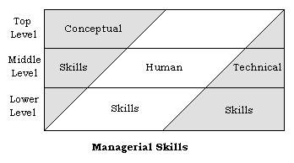
Managerial Skills
Managerial Skills
Professor Robert L. Katz has popularized the concept of "Managerial Skills" which was earlier developed by Henri Fayol.
Technical skills
Human skills
Conceptual skills
5 more skills can be stated : 1. Design skills 2. Administrative skills 3. Decision Making skills 4. Communication skills 5. Leadership skills
Notes:
Technical skills
Knowledge and proficiency in a specific field
Human skills
The ability to work well with other people
Conceptual skills
The ability to think and conceptualize about abstract and complex situations concerning the organization

Slide 10
What is Management ?
The process of achieving the objectives of the business organization by bringing together human, physical, and financial resources in an optimum combination and making the best decision for the organization while taking into consideration its operating environment.
Notes:
Management is a subject with principles , concepts and theories .
People make the management of an organisation by engaging in various process : eg : Great Leaders , coo’s , Managers , executive body , employees etc managing
People to achieve organisation’s objective.
Functions in terms of Planning , Organising , Leading , Controlling in order to achieve the vision/mission .
Career : Sequence of activities, jobs, organizations and challenges constitute a career .

Slide 11
What is Management ?
It is….
A Discipline - Accumulated body of knowledge that can be learned
Human Activity - managing the most important asset of an organisation ie People
Process – involving certain functions and activities.
Notes:
Management is a subject with principles , concepts and theories .
People make the management of an organisation by engaging in various process : eg : Great Leaders , coo’s , Managers , executive body , employees etc managing
People to achieve organisation’s objective.
Functions in terms of Planning , Organising , Leading , Controlling in order to achieve the vision/mission .
Career : Sequence of activities, jobs, organizations and challenges constitute a career .

Slide 12
Thus Management is ….
Management is the Process of “getting things done through the efforts of others”,getting from where we are to where we want to be with the least expenditure of time,money and efforts.
Coordinating individual and group efforts towards superordinate goals.

Slide 13
Who Are Managers?
Manager
Someone who works with and through other people by coordinating and integrating their work activities in order to accomplish organizational goals.
Classification
First-line Managers
Are at the lowest level of management and manage the work of non-managerial employees.
Middle Managers
Manage the work of first-line managers.
Top Managers
Are responsible for making organization-wide decisions and establishing plans and goals that affect the entire organization.

Slide 14
What do Managers Do ?
Luther Gullick has given a keyword ’POSDCORB’ where P stands for Planning, O for Organizing, S for Staffing, D for Directing, Co for Co-ordination, R for reporting & B for Budgeting. But the most widely accepted are functions of management given by KOONTZ and O’DONNEL i.e. Planning, Organizing, Staffing, Directing and Controlling

Slide 15
What do Managers Do ?
Functional Approach
Planning
Defining goals, establishing strategies to achieve goals, developing plans to integrate and coordinate activities.
Organizing
Arranging work to accomplish organizational goals.
Staffing
Recruitment of right person for the right job.
Directing
Working with and through people to accomplish goals.
Controlling
Monitoring, comparing, and correcting the work.

Slide 16
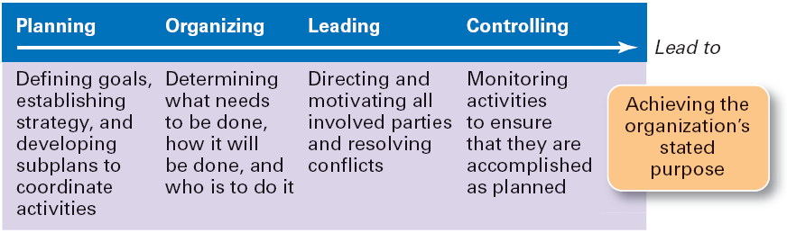
Managers do Management
Notes:
For doing these functions managers need Skills .

Slide 17
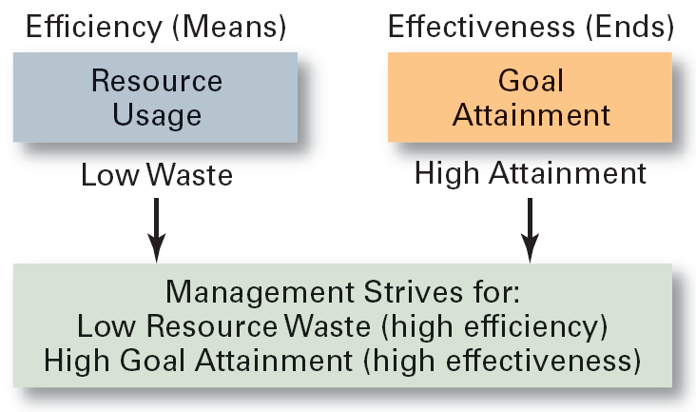
What do Managers do ?
Efficiency
“Doing things right”
Getting the most output for
the least inputs
Effectiveness
“Doing the right things”
Attaining organizational goals

Slide 18
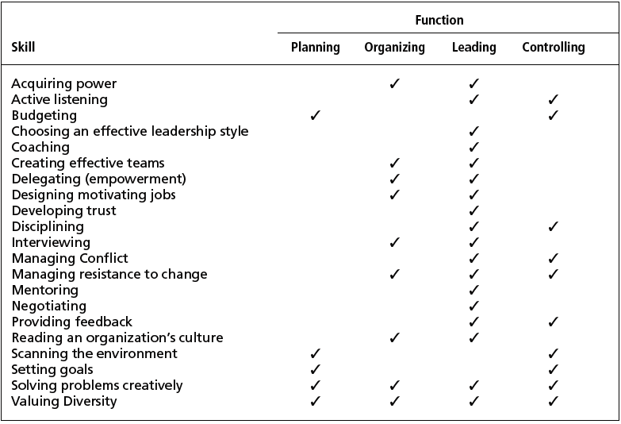
Management Skills and Management Function Matrix

Slide 19
What Roles do Managers Play ?
Management Roles Approach
Interpersonal roles
Figurehead, leader, liaison
Informational roles
Monitor, disseminator, spokesperson
Decisional roles
Disturbance handler, resource allocator, negotiator

Slide 20
Mintzberg’s 10 Managerial Roles
INTERPERSONAL
Figurehead Performs ceremonial and symbolic duties such as greeting visitors, signing legal documents
Leader Direct and motivate subordinates, training, counseling, and communicating with subordinates
Liaison Maintain information links both inside and outside organizaion; use mail, phone calls, meetings
INFORMATIONAL
Monitor Seek and receive information, scan periodicals and reports, maintain personal contacts
Disseminator Forward information to other organization members; send memos and reports, make phone calls
Spokesperson Transmit information to outsiders through speeches, reports, memos; represent departmental interests

Slide 21
Mintzberg’s 10 Managerial Roles
DECISIONAL
Entrepreneur Initiate improvement projects, identify new ideas, delegate idea responsibility to others
Disturbance Handler Take corrective action during disputes or crises; resolve conflicts among subordinates; adapt to environmental crises
Resource Allocator Decide who gets resources, scheduling, budgeting, setting priorities
Negotiator Represent department during negotiation of union contracts, sales, purchases, budgets

Slide 22
How The Manager’s Job Is Changing
The Increasing Importance of Customers
Customers: the reason that organizations exist
Managing customer relationships is the responsibility of all managers and employees.
Consistent high quality customer service is essential for survival.
Innovation
Doing things differently, exploring new territory, and taking risks
Managers should encourage employees to be aware of and act on opportunities for innovation.

Slide 23
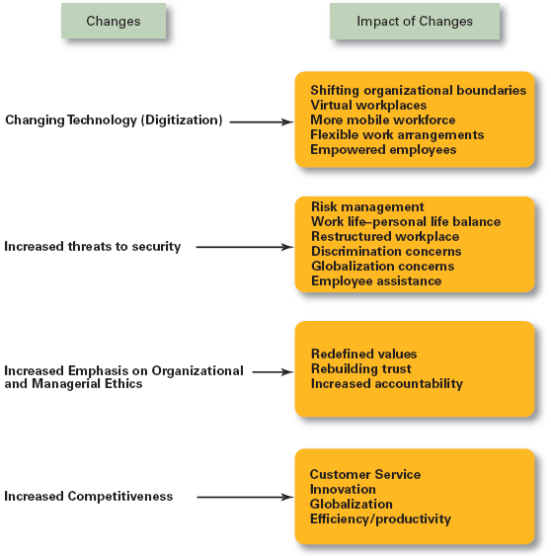
Changes Impacting the Manager’s Job

Slide 24
Forces Influencing Organizations and Management
Social Forces - values, needs, and standards of behavior
Political Forces - influence of political and legal institutions on people & organizations
Economic Forces - forces that affect the availability, production, & distribution of a society’s resources among competing users

Slide 25
Scientific Management
Fredrick Winslow Taylor – ( 1856-1915 )The “father” of scientific management. Published Principles of Scientific Management (1911) .
The theory of scientific management
Using scientific methods to define the “one best way” for a job to be done.
Putting the right person on the job with the correct tools and equipment.
Having a standardized method of doing the job.
Providing an economic incentive to the worker.

Slide 26
Scientific Management 4 principles
Develop a science for each element of an individual’s work, which will replace the old rule-of-thumb method.
Scientifically select and then train, teach, and develop the worker.
Heartily cooperate with the workers so as to ensure that all work is done in accordance with the principles of the science that has been developed.
Divide work and responsibility almost equally between management and workers.

Slide 27
Scientific Management
Employers to pay more productive workers higher rate than others. Using a “scientifically correct “rate that would benefit both the company and workers.
Thus the workers were urged to surpass their previous performance standards to earn more pay
Taylor called his plane the differential rate system.

Slide 28
Scientific Management
Contributions
Demonstrated the importance of compensation for performance.
Initiated the careful study of tasks and jobs.
Demonstrated the importance of personnel and their training.
Criticisms
Did not appreciate social context of work and higher needs of workers.
Did not acknowledge variance among individuals.
Tended to regard workers as uninformed and ignored their ideas

Slide 29
Limitations of Scientific Management Theory
Although Taylor's method led to dramatic increase in productivity and higher pay in number of instance , Workers and unions began to oppose his approach because they feared that working harder or faster would exhaust whatever work was available Causing layoffs.
Taylors system clearly meant that time was of the essence .
– His critics objected to the speed up condition that placed undue pressure on employees to perform at faster and faster levels.
– The emphasis on productivity and by extension profitability led some managers to exploit both the workers and customers.
– As a result more workers joined unions and thus reinforced a pattern of suspicious and mistrust that shaded labor relations for decades.
Notes:
Contributions
Demonstrated the importance of compensation for performance.
Initiated the careful study of tasks and jobs.
Demonstrated the importance of personnel and their training.
Criticisms
Did not appreciate social context of work and higher needs of workers.
Did not acknowledge variance among individuals.
Tended to regard workers as uninformed and ignored their ideas

Slide 30
Administrative Principles
Contributors: Henri Fayol, Mary Parker, and Chester I. Barnard
Focus:
Organization rather than the individual
Described the management functions of planning, organizing, commanding, coordinating, and controlling

Slide 31
Administrative Principles
Henry Fayol (1841-1925) :
Divided the manager’s job into five functions:
Planning, organizing, staffing, commanding, coordination, and control.
Developed 14 universal principles of management.
Fayol divided general and industrial management into following six groups
Technical activities (production, manufacture, adaptation).
Commercial activities (buying, selling and exchange).
Financial activities (search for and optimum use of capital).
Security activities (protection of property and persons).
Accounting activities (stock taking, balance sheet, cost, and statistics).
Managerial activities (planning, organising, command, coordination and control)
Notes:
In America early focus was worker productivity; in France, the focus was organization and its administration by engineer Henri Fayol, director of Comambault, the French mining company.
B. 1918, Industrial and General Administration - translated into English in 1930's to impact US management in Classical organization theory.
C. "Fourteen principles” of organization identified general rules that successful organizations ought to follow:
Division of work – work and tasks should be perform by people specialized in the work and similar tasks should be organized as a unit or department.
Authority – delegated persons ought to have the right to give orders and expect that they be followed.
Discipline – workers should be obedient and respectful of the organization
Unity of command – employees should receive orders from only one person with authority
Unity of direction – the organization and employees are dedicated to one plan of action or set of objectives.
Subordination of individual interests to the general interest – organizational conflict should be limited by the dominance of one objective.
Remuneration – although Fayol provides no guidance on pay, the organization must recognize the economic value of employees and that their economic interests are important.
Centralization – whether an organization should be centralized or decentralized depends upon such factors as communications and the importance of who should make the decision.
Scalar chain – authority in an organization moves in a continuous chain of command from top to bottom.
Order – everything, people and resources, has a place that it belongs.
Equity – fairness is important in management-employee relations
Stability of tenure of personnel – turnover is disruptive; shared experience is important
Initiative – Workers are exhorted to be productive and motivated.
Esprit de corps – there is a need for harmony and unity within the organization

Slide 32
Henri Fayol 1841-1925
14 General Principles of Management
Division of labor
Authority
Discipline
Unity of command
Unity of direction
Subordination of individual interest
Remuneration
Centralization
Scalar chain
Order
Equity
Stability and tenure of staff
Initiative
Esprit de corps

Slide 33
Fayol’s Contribution
He gave overall concepts of general management and suggested the basic functions of management.
He recommended the selection and training of workers and managers.
He also advocated the use of organisation charts. He suggested certain qualities of manager’s winch include physical, mental, moral, educational technical and experience.
Fayol’s theory of management was the first complete theory of management as we understand today. It incorporated proven principles, elements, procedures and techniques based on his practical experience.
Henry Fayol came to be recognised as the founder of modern management theory.

Slide 34
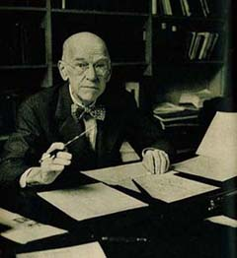
Elton Mayo and Hawthorne Studies
Elton Mayo : Believed emotional factors were more important determinants of productive efficiency than were physical and logical factors.
Conducted the Hawthorne Experiments : Demonstrated the importance of understanding how the feelings, thoughts, and behavior of work-group members and managers affect performance

Slide 35
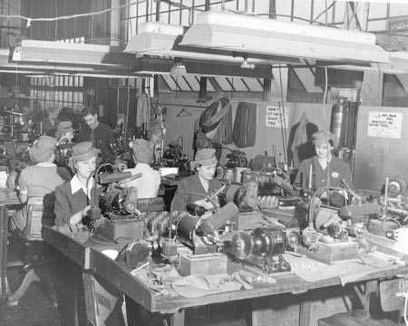
Hawthorne Studies
The Hawthorne studies were carried out by the Western Electric company at their Hawthorne plant in the 1920's.
Ten year study
1924 - Chicago
Research focus: Relation of quality and quantity of illumination to efficiency in industry
Four Important Studies
Illumination study
Relay assembly test room study
Interviewing program
Bank wiring room observation study
Notes:
Mayo’s HAWTHORNE STUDIES

Slide 36
The Hawthorne Studies
Illumination Study (November 1924)
Designed to test the effect of lighting intensity on worker productivity , Experiment indicated that Productivity increased when studies were on and slumped when the study got over as workers were motivated due to the interest shown by management .
The mere practice of observing people’s behavior tends to alter their behavior and is called (Hawthorne Effect)
This formed the basis of the Further Experiments done by Mayo .

Slide 37
Relay Assembly Test Room Study (1927-1932)
Assembly of telephone relays (35 parts - 4 machine screws)
Researchers spent five years measuring how different variables impacted the group's and individuals' productivity. Some of the variables were:
changing the pay rules so that the group was paid for overall group production, not individual production
giving two 5-minute breaks (after a discussion with them on the best length of time), and then changing to two 10-minute breaks (not their preference). Productivity increased, but when they received six 5-minute rests, they disliked it and reduced output.
providing food during the breaks
shortening the day by 30 minutes (output went up); shortening it more (output per hour went up, but overall output decreased); returning to the first condition (where output peaked).

Slide 38
Relay Room Experiment
Production and satisfaction increased regardless of IV manipulation (payrate , break interval , meals , hours of work )
Workers’ increased production and satisfaction related to supervisory practices
Human interrelationships are important contributing factors to worker productivity
Bottom Line: Supervisory practices increase employee morale AND productivity
What Really Increased the Productivity?
choosing one's own coworkers, working as a group, being treated as special (as evidenced by working in a separate room), and having a sympathetic supervisor were the real reasons for the productivity increase

Slide 39
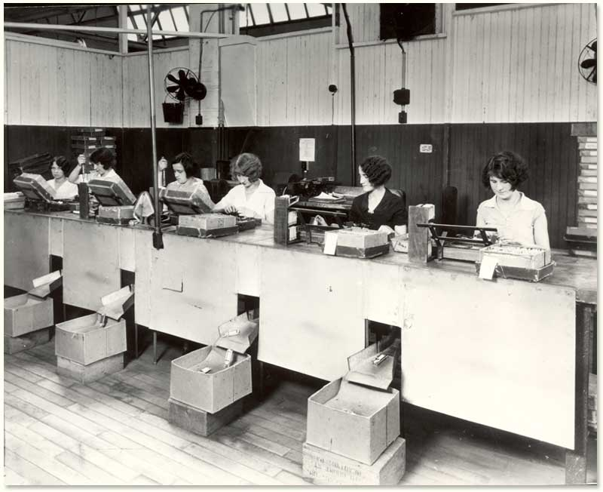
Relay Room Experiment
Women in the Relay Assembly Test Room, ca. 1930 Western Electric Company Hawthorne Studies Collection © 2007 President and Fellows of Harvard College; all rights reserved.

Slide 40
Interviewing Program (1928-1930)
Investigate connection between supervisory practices and employee morale
The results proved that upward communication in an organisation creates a positive attitude in the work environment.
The workers feel pleased that their ideas are being heard.

Slide 41
Bank Wiring Experiment
The purpose of the next study was to find out how payment incentives would affect productivity.
The surprising result was that productivity actually decreased, because the men were afraid that the company would lower the base rate and had a clear idea of a fair day’s work .
Workers apparently had become suspicious that their productivity may have been boosted to justify firing some of the workers
Done on group of fourteen men who put together telephone switching equipment.
There was existence of informal groups or "cliques" within the formal groups. These cliques developed informal rules of behavior as well as mechanisms to enforce them. The cliques served to control group members and to manage bosses; when bosses asked questions, clique members gave the same responses, even if they were untrue.

Slide 42
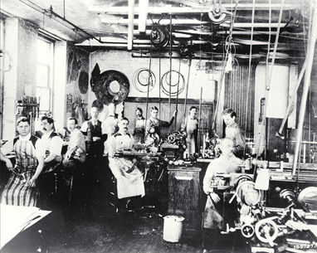
Bank Wiring Experiment
What Really reduced the productivity ?
Workers were more responsive to the social force of their peer groups than to the control and incentives of management.
Conclusion: Social groups can influence production and individual work behavior. Informal organization constrains employee behavior within formal organizational structure

Slide 43
Implications of Hawthorne Studies
Illumination Study (November 1924)
The mere practice of observing people’s behavior tends to alter their behavior (Hawthorne Effect)
Relay Assembly Test Room Study (1927-1932)
Relationships between workers and their supervisors are powerful
Human interrelationships / informal group increase the amount and quality of worker participation in decision making
Interviewing Program (1928-1930)
Demonstrated powerful influence of upward communication
Workers were asked for opinions, told they mattered, and positive attitudes toward company increased
Bank Wiring Room Observation Study (November 1931 - May 1932)
Led future theorists to account for the existence of informal communication
Taken together, these studies helped to document the powerful nature of social relations in the workplace and moved managers more toward the interpersonal aspects of organizing.

Slide 44
Important Aspects of the behavioral science approach
Communication
Employee development
Leadership
Employee motivation
Organization as social system

Slide 45
ASSUMPTIONS OF BEHAVIORAL SCIENCE APPPROACH
Organisations are socio-technical systems. The management must integrate both the systems.
Work and interpersonal behaviour of people in the organisation is influenced by many factors.
Employees are motivated not only by physiological needs but also by social and psychological needs.
Different people have different perceptions, attitudes, needs and values. These differences must be found out and recognised by management.
In an organisation conflicts are unavoidable.
Personal goals and Organisational goals must be joined together.

Slide 46
Management Science Perspective : MODERN THEORY
Systems Theory
Contingency Theory

Slide 47
Why did modern theory emerge?
Emerged after WW II
Applied mathematics, statistics, and other quantitative techniques to managerial problems
Operations Research – mathematical modeling
Operations Management – specializes in physical production of goods or services
Information Technology – reflected in management information systems

Slide 48
THE SYSTEMS APPROACH

Slide 49
The meaning of SYSTEM
Taken from a greek word which means to bring together or to combine.
Father of systems approach: Ludvig von Bertalanffy.
According to Ludvig Von Bertalanffy, “In order to understand an organized whole, we must know both the parts as well as relations between them.”
Notes:
1. It is a set of inter related parts which work together to achieve certain goals.

Slide 50
Classification OF SYSTEMS
Open systems: an open system actively interacts with its environment. By interacting with other systems, it tries to establish exchange relationships.
Close systems: It is self contained and isolated from the environment. It is a non adaptive system. It does not receive inputs from other systems and does not trade with the outside world.

Slide 51
ELEMENTS OF SYSTEMS MANAGEMENT
The systems management theory has had a significant effect on management science. A system is an interrelated set of elements functioning as a whole. It has subsystems which have synergy between them. Each subsystem has its defined boundaries. An organization as a system is composed of four elements:
Inputs — material or human resources
Transformation processes — technological and managerial processes
Outputs — products or services
Feedback — reactions from the environment

Slide 52
Open system view of an organization
ENVIRONMENT
INPUTS
Raw material
TRANSFORMATION
PROCESS
Employees’ work activities
OUTPUTS
Production and services
Human resource
Capital
Technology
Information
Management activities
Technology and operations methods
Financial results
Human results
Information
SYSTEM
FEEDBACK

Slide 53
CONTRIBUTIONS OF THIS APPROACH TO MANAGEMENT
Under systems approach, managers have a good view of the organisation.
It gives importance to interdependence of the different parts of an organisation and its environment.
It foretastes consequences and plans actions.
Systems thinking warns managers against adopting piecemeal approach to the problem-solving.

Slide 54
THE CONTINGENCY APPROACH

Slide 55
Meaning of contingency view (Also known as situational view)
It emphasizes that there is no best way to manage. It is an “it all depends” approach.
The appropriate management actions and approaches depend on the situation.
Managers with a contingency view use a flexible approach, draw on a variety of theories and experiences, and evaluate many options as they solve problems.
It tries to identify the best technique that will be effective in a particular situation at a particular time.
This attempts to integrate all the management approaches.

Slide 56
Features of contingency approach
CONTINGENCY MANAGEMENT RECOGNIZES THAT THERE IS NO ONE BEST WAY TO MANAGE
In the contingency perspective, managers are faced with the task of determining which managerial approach is likely to be most effective in a given situation.
Contingency thinking avoids the classical “one best way” arguments and recognizes the need to understand situational differences and respond appropriately to them.
Contingency theory is a recognition of the extreme importance of individual manager performance in any given situation.
The contingency approach is highly dependent on the experience and judgment of the manager in a given organizational environment.
Notes:
1. For example, the approach used to manage a group of teenagers working in a fast‐food restaurant would be very different from the approach used to manage a medical research team trying to find a cure for a disease.

Slide 57
The Contingency Approach
Contingency Approach Defined
Also sometimes called the situational approach.
There is no one universally applicable set of management principles (rules) by which to manage organizations.
Organizations are individually different, face different situations (contingency variables), and require different ways of managing.
Popular Contingency Variables
Organization size
Routineness of task technology
Environmental uncertainty
Individual differences

Slide 58
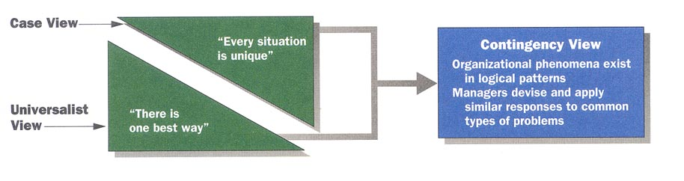
Contingency View of Management
Successful resolution of organizational problems is thought to depend on managers’ identification of key variations in the situation at hand

Slide 59
RELATIONSHIP between systems and contingency approaches
Contingency management school has emerged out of systems management school.
The contingency theorists have accepted the basic tenets of system management school.
They accept the basic features of organizational environment relationship and dynamic nature of organization.
Since the system approach is too abstract to apply certain modifications can be made and then applied for managerial action.
The systems approach may specify situations under which an organization can function, whereas, the contingency approach can specify the processes by which the organization may try to adapt its environment.
Notes:
1. They accept the basic features of organizational environment relationship and dynamic nature of organization.

